Slide 1
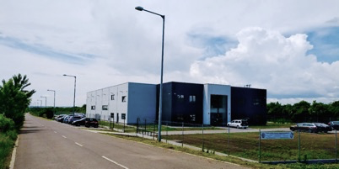
Pannon Concept Ltd.
Presenting

Slide 2





Value Proposition
Concept »»» Create »»» Innovate !
Our Mission:
To improve overall efficiency of production with our custom tailored, innovative engineering solutions in various field of industry.

Slide 3



Value Proposition
Our Mission – Your Goal !
Improve:
efficiency
quality
throughput
Reduce:
cost
downtime
changeover
Concept »»» Create »»» Innovate !

Slide 4
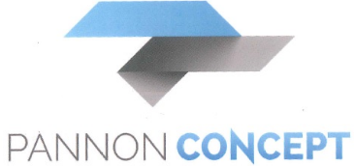
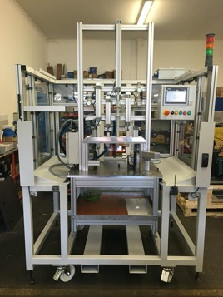
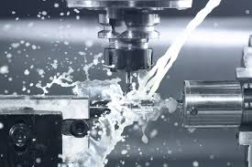
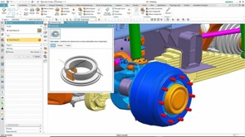
Quick facts
Established in 2009
Site: Gyöngyös, East Hungary (1hr drive to Budapest)
Staff of 30 people (incl.5 CAD, 1 Electrical Eng.)
Turnover ~2,5m EUR
Market: Automotive, Energy, Packaging
Main scope:
Design »» Milling (3-4-5 axis), turning »» Assembly

Slide 5
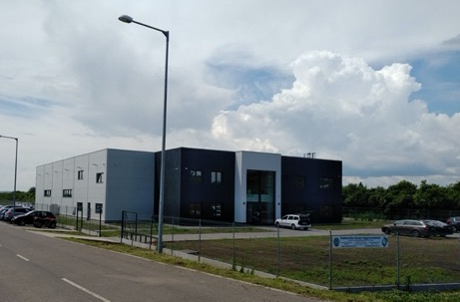
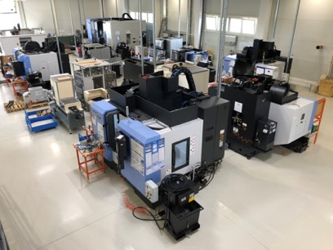
New Facility
Green field investment. Building erected: November 2018
Total floor space: 1450 sqm
Office space floor: 450 sqm
Workshop space floor: 1000 sqm
Planned expansion in 2021: adding 900 sqm workshop for assembly
PANNON CONCEPT kft.

Slide 6
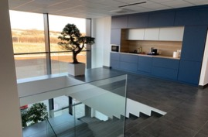
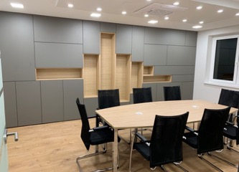
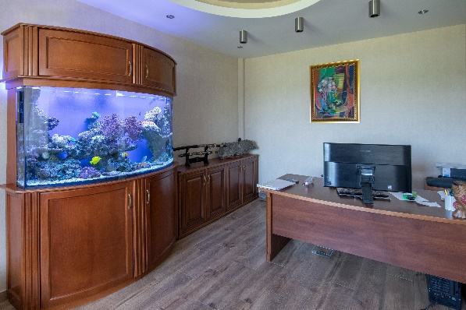
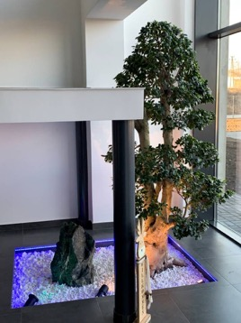
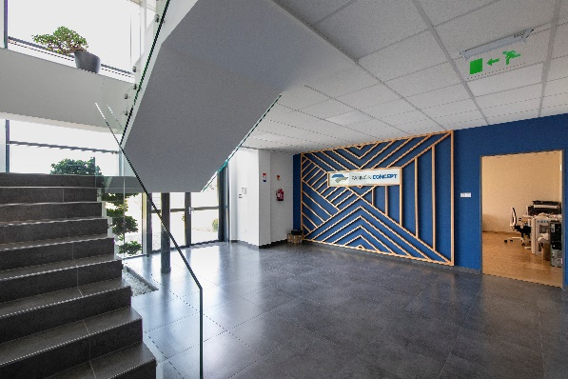
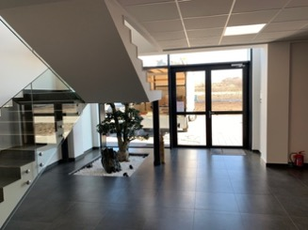
Interior
PANNON CONCEPT kft.

Slide 7
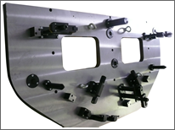
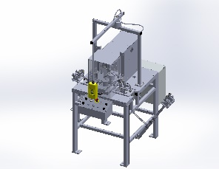
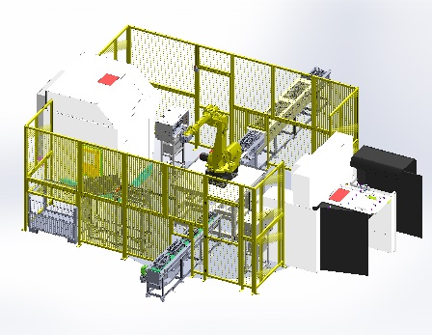
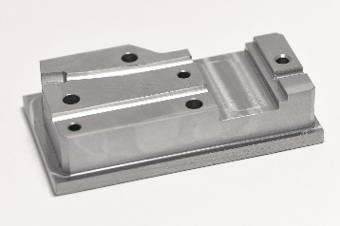
Key Competences
Fixturing
Pneumatic
Hydraulic
Custom
Machines
Inspection
Manufacturing
Manual
Automation
&
Robot Cell Integration
Subcontracting machining
&
CMM measurement
Assembly

Slide 8

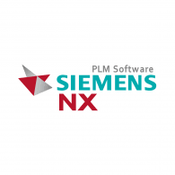



Technology
Our design and manufacturing is brought to you by:
CAD
CAM
Machining
And our high quality is assured by:
CMM + PH10 SP25 + Laser Scanning
Inspection Probing

Slide 9





Technology
Preferred pneumatic system suppliers:
Preferred plc system suppliers:

Slide 10

Machine Yard
CNC Milling Centers (Qty 7):
5 AXIS simul.: 1x DOOSAN AN VCF 8500 5 axis (D 800, X: 3000, Y: 850 Z: 800)
4 axis pallet changer: 1x DOOSAN VC510 (X: 762, Y: 516, Z: 570)
3 AXIS:
1x DOOSAN DNM 500 ( X:1020, Y:540, Z:510 )
2x Doosan MYNX 6500 ( X:1270, Y:670, Z:625 )
1x FANUC T14iFLB ( X:700, Y:400, Z:330 )
1x TT DNC 5000 Portal milling machine ( X:4000, Y:2000, Z:400 )
CNC Lathes:
- 2x, DOOSAN PUMA GT2100M (D220 x 600)
EDMs:
- 2x Sodick AQ400L
CMM machines:
- 1x Mitutoyo Crystal-Apex S 9206 + Renishaw PH10MQ + laser scanning sensor
Grinding machines:
- 1x ESG-2040TDS flat grinding machine ( X:1020, Y:550, Z:530 )
- 1x KP-100-02 cylinder grinding machine
Traditional machines: Lathe-, and Milling machine, Saw, Column drilling machine

Slide 11
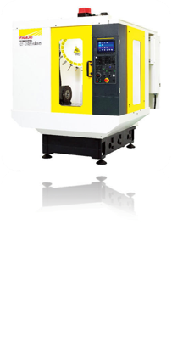
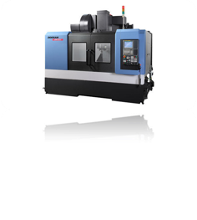
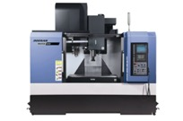


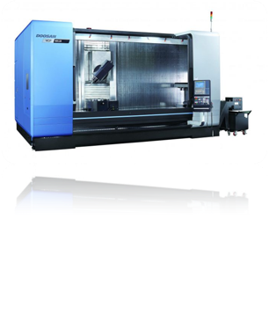
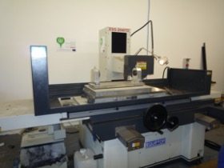
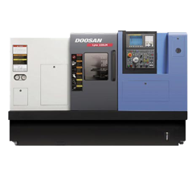


9 CNC Machining Centers & Lathes
DOOSAN DNM 500 (QTY 2)
X1020 Y:540 Z:510
DOOSAN Mynx 6500 (Qty 1)
X:1270 Y:670 Z:625
FANUC Robodrill TI14iFLB (QTY 1)
X:700, Y:400, Z:330
DOOSAN VCF850LRR (QTY 1)
X:3500, Y:870, Z:800
Griding Machine (QTY 1)
X:1020 Y:550 Z:530
DOOSAN Lynx 220 (QTY 2)
D 220 x 600

Slide 12
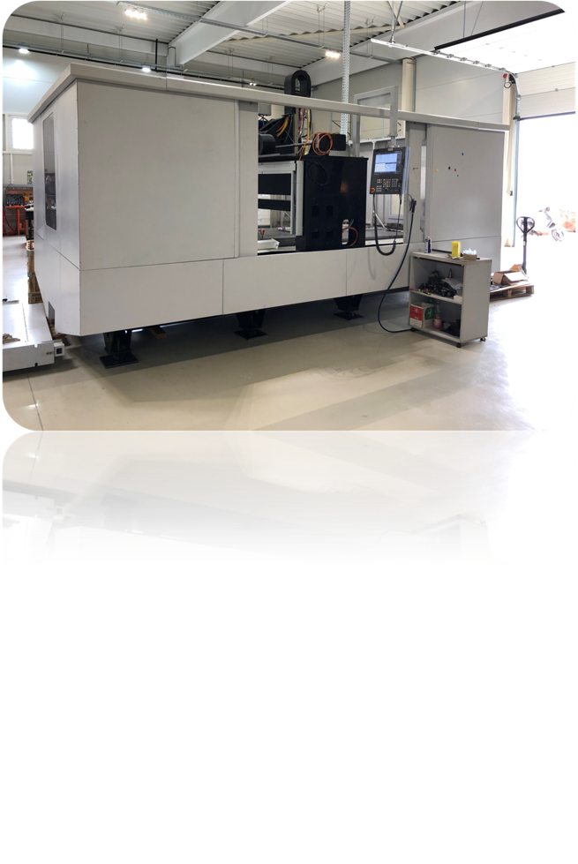
CNC Portal Milling (custom design)
TT DNC 5000 poral milling
X:4000, Y:2000, Z:400

Slide 13
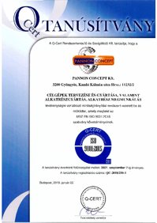
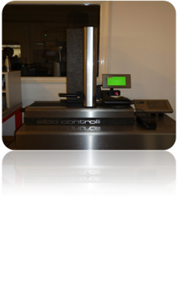
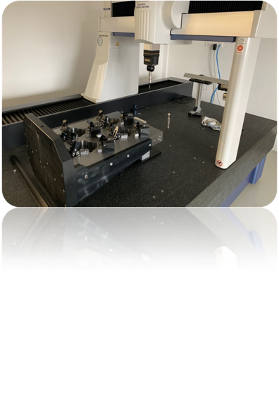
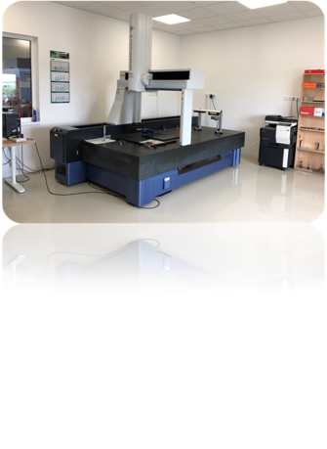

Quality Control
Mitutoyo CMM + Renishaw PH10 + SP25 + Laser scanning probe
Tool measuring
Hard gauges
Mitutoyo Apex S
X:900 Y:2000 Z:600

Slide 14
Businesses
Core Businesses
Custom Fixturing
Custom Machines
Contract Machining & CMM Measuring
Automation & Robot Integration

Slide 15
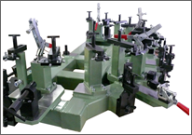
Custom Fixturing
By application:
For machining centers, CMMs and ass’y machines
For manually operated fixtures
By operation:
Pneumatic fixtures
Hydraulic fixtures
with external pipes
with internal holes
Upgrading 3 axis machining centres to 4 and 5 axis
Work offsets
Hydraulic systems

Slide 16
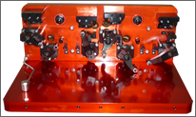
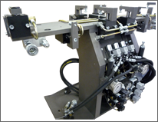
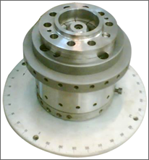
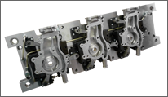
Fixtures for Milling

Slide 17
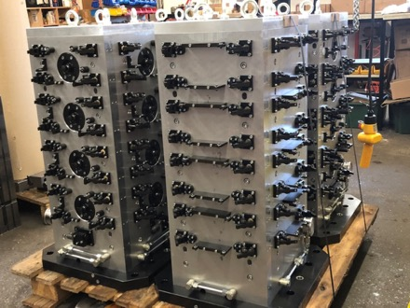
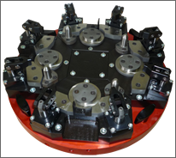
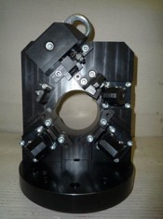
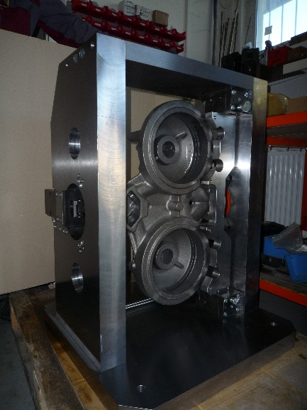
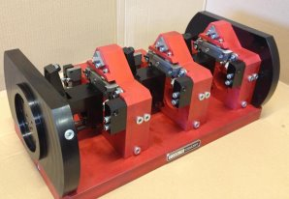
Fixtures for Machining Centers

Slide 18
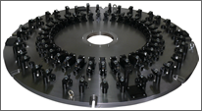
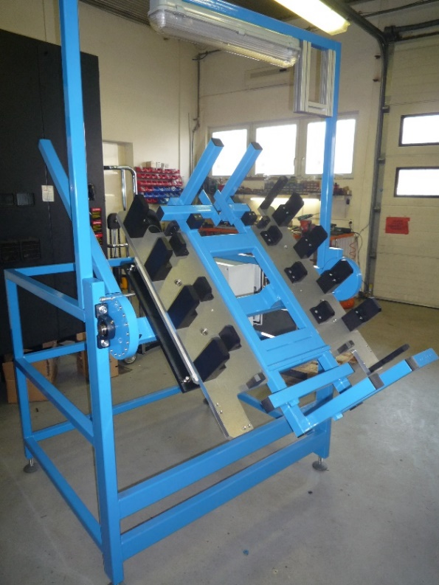
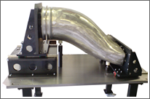
Oversized Welding and Ass’y Fixtures

Slide 19
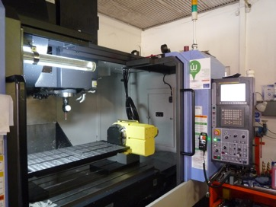
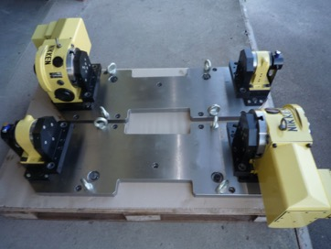
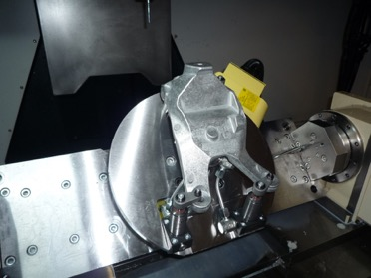
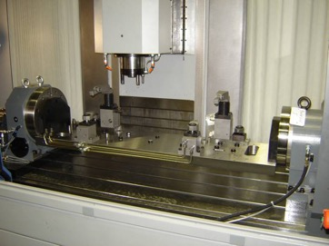

4th axis upgrade for machining centres

Slide 20
Businesses
Core Businesses
Custom Fixturing
Custom Machines
Contract Machining & CMM Measuring
Automation & Robot Integration

Slide 21
Custom Machines
Our key competence is to provide custom machines to our customers from R&D through manufacturing to assembly, installation and training.
Applications:
Checking, inspection and measuring machines
Pressing machines
Custom milling/turning machines
Full-scale robot cell integration
Assembly machines
Leak detector machines
Engraving machines
PANNON CONCEPT kft.

Slide 22
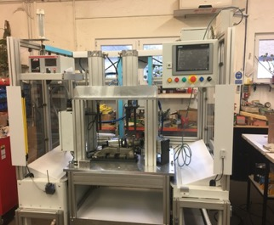
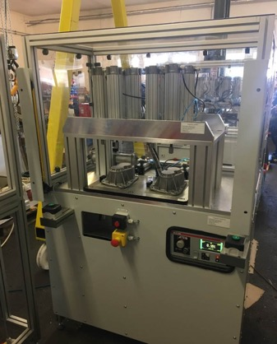
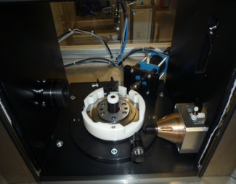
Custom machines
Leak detectors
PANNON CONCEPT kft.

Slide 23
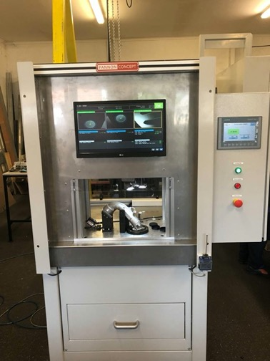

Custom machines
Inspection and measuring machines
PANNON CONCEPT kft.

Slide 24



Custom machines
Pressing machines

Slide 25




Custom machines
Manuf. Custom
Machines
Multiple threading machine

Slide 26





Custom machines
Various Applications
Edging
Sawing-positioning
Threading
Washing-
Painting-
Drying
Threading

Slide 27
Businesses
Core Businesses
Custom Fixturing
Custom Machines
Contract Machining & CMM Measuring
Automation & Robot Integration

Slide 28





Conveyor Systems
PANNON CONCEPT kft.

Slide 29




Robot Cell Integration - Industrial
PANNON CONCEPT kft.

Slide 30



Turn-key Robot Cell Integration - Industrial
PANNON CONCEPT kft.

Slide 31


Turn-key Collaborative Robot Solutions
Simple to install, can be mobilized easily
Safe: human friendly operation (No fence!)
Easy to teach & program
Fast return of investment
PANNON CONCEPT kft.

Slide 32


Collaborative Robot Applications
CNC Machine Feeding
Pick & Place
Inspection
Assembly (Scew, Gear)
Polishing & Deburring
Plastic Injection Assist.
Packaging & Palletizing
Press Forming Assist.
Gluing / Bonding
PANNON CONCEPT kft.

Slide 33
Businesses
Core Businesses
Custom Fixturing
Custom Machines
Contract Machining & CMM Measuring
Automation & Robot Integration

Slide 34





Subcontract Machining

Slide 35
Subcontract Machining
Turning OD 200 x 600 »»» +100k qty pa
Milling 3000 x 800 x 800 »»» +1k qty pa
» Milling in 3, 3+2, 5 axis
Supporting
Automotive
Energy
General Machine
Packaging

Slide 36
















References
PANNON CONCEPT kft.

Slide 37

Please visit us online or be our guest in our new, Gyöngyös facility!
PannonConcept kft
3200 Gyöngyös, Industrial Park, Kandó Kálmán street 11232/2
www.pannonconcept.hu
csontosbela@pannonconcept.hu

